Slide 1

Natural Language Processing with Bag of Words Models
Matthew Engelhard
Notes:
Hi everyone
In this lecture, we’ll be kicking off our natural language processing content
by learning about bag of words models for document classification
These models view documents as a bag of words in the sense that the
feature vector they use to represent documents will depend only on
which words are present in each document, and not on the order in which they appear
We’ll see how these models solve the central problem of natural language processing,
namely, how to convert text to features that we can use in a predictive model
Even though the bag of words approach is simple, it’s quite powerful,
and tends to work quite well for many biomedical natural language processing tasks

Slide 2

Lecture 1: what is a predictive model?
y, associated value or label
x, data/features for a subject or patient
End goal: predict y from x
Notes:
Going all the way back to our early lectures, we know that a predictive model is a machine that converts a vector of numeric features, x, into a prediction about a value, y, that is associated with those features
For many models, the features are a fairly short list of numeric attributes. In the APACHE III model, for example, which predicts mortality risk for ICU patients, the features are vital signs and other patient attributes collected at the time of admission. And when the features are small in number and represent distinct pieces of information, often a simple model, such as logistic regression, will perform well.

Slide 3
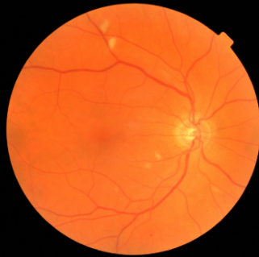
CNN: a predictive model for image data
y, referrable diabetic retinopathy
x, retinal image
End goal: predict y from x
Notes:
In computer vision, on the other hand, the features are the different pixels present in images
And these pixels are part of a rich, spatial structure – in other words, the positions of the pixels in relation to one another is important
As a result, a kind of model that takes advantage of that spatial structure – this model is called a convolutional neural network --
Is much better at extracting information from images than logistic regression and other simple models

Slide 4
NLP: a predictive model for text data
y, abnormality present
x, radiology report
End goal: predict y from x
Notes:
Today, we’re going to consider a new kind of predictive model, one in which the input to the model is a text document, and the output is a label associated with that document
For example, the input might be a radiology report, and the output might be a binary label indicating whether an abnormal finding was noted in the report
But as we know, all our predictive models – logistic regression, MLP, CNN – they all work with numbers
So, right from the start we’re faced with a difficult problem – how can we convert a document into a feature vector that encodes its contents?
If we can do that, we can then apply any of the classification models we’ve previously discussed
So, that’s the problem we’ll be solving today.

Slide 5

Case Study: SMS Triage for Global Maternal Health
Maternal Health HelpDesk:
2 million women connected to NDoH staff via SMS
https://www.praekelt.org
Binary Classification: Urgent Message? (Yes/No)
Notes:
Let’s make things a little bit more concrete as we work through this process
We’ll consider a predictive model that receives as input a short text message related to maternal health
And predicts whether that message is urgent, meaning that it requires an immediate response from a healthcare provider
This is a binary classification model – either a message is urgent, or it’s not – and it’s one that was really developed to support expecting and new mothers in South Africa.

Slide 6
A Simple Predictive Model: ICU Mortality
???
WBC Count
Respiratory Rate
Creatinine
Mean BP
Hematocrit
Age
Temperature
Pulse Rate
Survival
End goal: predict odds of hospital mortality
Notes:
Once again, for a model like APACHE III, the features are numeric measurements
And the order of these measurements is important, because each element of the feature vector corresponds to one or more specific model parameters
We can think of our features as an ordered list of specific patient characteristics that can be quantified for each patient
So, what we’re looking for is an ordered list of specific document characteristics that can be quantified for each document

Slide 7
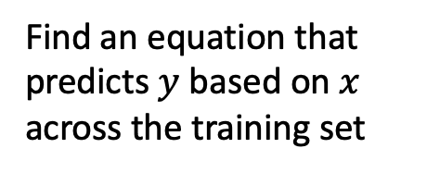
Training Set (Historical Data)
x₁
y₁
Find an equation that predicts $y$ based on $x$ across the training set
x₂
y₂
x₃
y₃
x₄
y₄
…
…
x_{N-1}
y_{N-1}
x_{N}
y_{N}
Notes:
Previously, we discussed how we train our predictive models
We gather a bunch of historical data, which we call the training set
We choose a model, for example logistic regression
And we choose parameters of that model that result in the best predictions, on average, across the training set

Slide 8

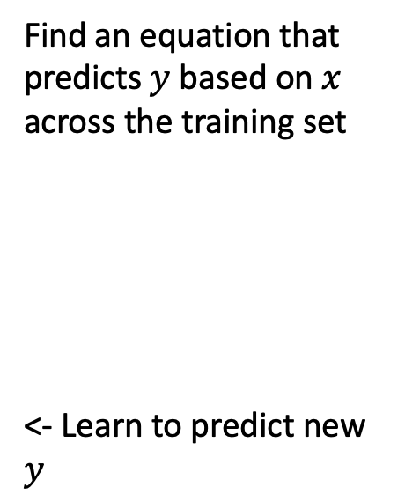
Making Predictions for New $x$
x₁
y₁
x₂
y₂
Find an equation that predicts $y$ based on $x$ across the training set
<- Learn to predict new $y$
x₃
y₃
x₄
y₄
…
…
x_{N-1}
y_{N-1}
x_{N}
y_{N}
x_{N+1}
y_{N+1}
Notes:
Once we’ve done that, we freeze the parameters
And we can use our model – our machine – to make predictions for the y values associated with features x it hasn’t seen before

Slide 9
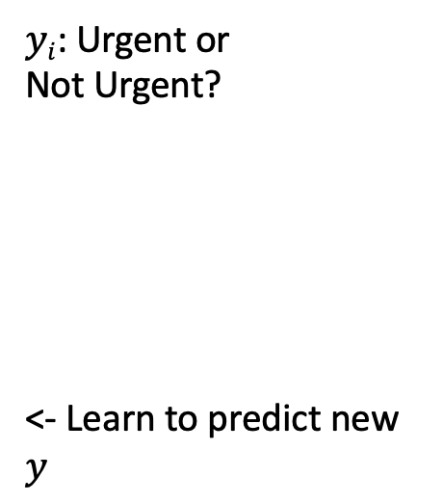
This time, our training data is text
x₁
What helps with morning sickness?
How many months should I breastfeed?
I passed out and Mom said I was shaking
Where is the nearest clinic?
I am having heavy bleeding, what should I do?
What foods should I eat while pregnant?
My heart is racing and I can’t catch my breath
y₁
x₂
y₂
x₃
y₃
$yi$: Urgent or
Not Urgent?
<- Learn to predict new $y$
x₄
y₄
…
…
x_{N-1}
y_{N-1}
x_{N}
y_{N}
x_{N+1}
y_{N+1}
Notes:
But now, our training data looks like this instead.
We have a collection of text messages – these are messages sent by new or expecting mothers, questions about their health, their pregnancy, or their baby
And in these historical data we also have labels that tell us whether each message was determined to be urgent, or not, by the staff member who read it
We want our model to learn from these data to be able to predict whether newly received messages are urgent.

Slide 10
We need numbers, not words
Can we convert our text to a vector or sequence of numbers?
If yes, we can use logistic regression (or any other predictive model)!
Notes:
So again, we need to be able to convert these sentences to numbers
If we can do that, we’ll have the same setup we’re used to, and we can apply whatever binary classification model we like.
We’ll see over the next few lectures that there are several approaches that have been used.
We’ll begin with the simplest one.

Slide 11
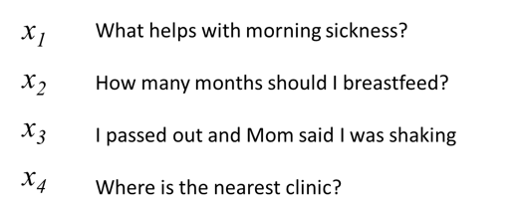
First try: count words in each SMS Step 1: Define a vocabulary of words
shaking
what
clinic
how
helps
was
nearest
many
with
said
months
the
morning
mom
should
sickness
and
I
is
how
out
breastfeed
passed
where
list of all words
(in no particular order)
Notes:
In the bag of words approach, our features correspond to specific words identified in our collection of documents – in this case, a collection of text messages
Each of these words will be present in some documents, and not in others
To construct the feature vector for a given document, we determine how many of each word of interest is present in that document
But before we can do that, we need to identify the full list of words we’re interested in
We’ll call this list of words our vocabulary
And we’ll create it by finding all the words that are present in any of the documents in our training data
Often we’ll filter this list to exclude words that are extremely common – words like ‘a’, ’the’, and so on
As well as words that are extremely uncommon, only appearing a small number of times in our training data
But for simplicity’s sake, in this example we’ll include all the words appearing in our example sentences

Slide 12
Step 2: count how many times each vocabulary word appears in a given SMS
shaking
what
clinic
how
helps
was
nearest
many
with
said
months
the
morning
mom
should
sickness
and
I
is
how
out
breastfeed
passed
where
What helps with morning sickness?
x₁
0 | 1 | 0 | 0 | 1 | 0 | 0 | 0 | 1 | 0 | 0 | 0 | 1 | 0 | 0 | 1 | 0 | 0 | 0 | 0 | 0 | 0 | 0 | 0
Notes:
The vocabulary is ordered: each word in the vocabulary corresponds to a specific position in our feature vector
Here, the word ‘shaking’ is the first word in our vocabulary. So, the number in the first element of the feature vector tells us how many times ‘shaking’ appears in the associated message (or document)
In this example, the text message “what helps with morning sickness” is converted to a vector by placing 1s in the positions corresponding to ’what’, ‘helps’, ‘with’, ‘morning’, and ‘sickness’ – and a 0 in all other positions
Again, the numbers indicate how many times the corresponding vocabulary word is present in that sentence.

Slide 13
Step 2: count how many times each vocabulary word appears in a given SMS
shaking
what
clinic
how
helps
was
nearest
many
with
said
months
the
morning
mom
should
sickness
and
I
is
how
out
breastfeed
passed
where
I passed out and Mom said I was shaking
x₃
1 | 0 | 0 | 0 | 0 | 1 | 0 | 0 | 0 | 1 | 0 | 0 | 0 | 1 | 0 | 0 | 0 | 2 | 0 | 0 | 1 | 0 | 1 | 0
Notes:
In this, second example, the word ‘I’ appears twice, so there is a 2 in the element of the feature vector corresponding to the word ‘I’

Slide 14
Step 2: count how many times each vocabulary word appears in a given SMS
shaking
what
clinic
how
helps
was
nearest
many
with
said
months
the
morning
mom
should
sickness
and
I
is
how
out
breastfeed
passed
where
Where is the nearest clinic?
x₄
0 | 0 | 1 | 0 | 0 | 0 | 1 | 0 | 0 | 0 | 0 | 1 | 0 | 0 | 0 | 0 | 0 | 0 | 1 | 0 | 0 | 0 | 0 | 1
Notes:
Here’s one final example to illustrate the concept.
Take a moment to make sure you understand how this feature vector is generated from the sentence “where is the nearest clinic”

Slide 15
Note that word order does not matter!
shaking
what
clinic
how
helps
was
nearest
many
with
said
months
the
morning
mom
should
sickness
and
I
is
how
out
breastfeed
passed
where
clinic is where nearest the
x_{4'}
0 | 0 | 1 | 0 | 0 | 0 | 1 | 0 | 0 | 0 | 0 | 1 | 0 | 0 | 0 | 0 | 0 | 0 | 1 | 0 | 0 | 0 | 0 | 1
Notes:
At this point, you may notice that this feature vector does not depend on the order of the words in the sentence
The vector simply indicates how many of each vocabulary word are present in the sentence.
But if we shuffled words in the sentence around, the resulting feature vector would be unchanged
For example, the message on the current slide – ‘clinic is where nearest the’ – results in the same feature vector as the previous message, ‘where is the nearest clinic’

Slide 16

A “bag of words”
clinic
nearest
where
the
is
Notes:
This is why we call it a bag of words – the model is only told which words are present, and not in what order
You might find it surprising that models with this property can perform extremely well
It turns out, for most prediction tasks, including our text message triage example, the order of words is not very important
When we see ‘clinic nearest where the is’, we understand the content even though it’s jumbled

Slide 17
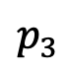
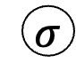
Logistic Regression for Text Classification
shaking
what
clinic
how
helps
was
nearest
many
with
said
months
the
morning
mom
should
sickness
and
I
is
how
out
breastfeed
passed
where
$$p_{3}$$
$$σ$$
z₃
b₁
b_{M}
x₃
1 | 0 | 0 | 0 | 0 | 1 | 0 | 0 | 0 | 1 | 0 | 0 | 0 | 1 | 0 | 0 | 1 | 2 | 0 | 0 | 1 | 0 | 1 | 0
I passed out and Mom said I was shaking
Notes:
Now that we know how to convert messages into a vector of features, we can use logistic regression

Slide 18
Logistic Regression for Text Classification
shaking
what
clinic
how
helps
was
nearest
many
with
said
months
the
morning
mom
should
sickness
and
I
is
how
out
breastfeed
passed
where
$$p_{3}$$
$$σ$$
z₃
b₁
b_{M}
x₃
1 | 0 | 0 | 0 | 0 | 1 | 0 | 0 | 0 | 1 | 0 | 0 | 0 | 1 | 0 | 0 | 1 | 2 | 0 | 0 | 1 | 0 | 1 | 0
I passed out and Mom said I was shaking
Notes:
During training, the model will learn that a few words substantially increase the log-odds that the message is urgent, as shown with the blue lines, which indicate positive model coefficients
In this case, the word ‘shaking’ is a good example of this
The words ‘clinic’, ‘sickness’, and ‘passed’ also increase the log-odds that the message is urgent, whereas the other words do not suggest the message is urgent, and instead decrease the log-odds slightly
Please note that we’re just illustrating the idea here – these don’t correspond to real coefficients in the model that was developed for this application.

Slide 19
Logistic Regression for Text Classification
shaking
what
clinic
how
helps
was
nearest
many
with
said
months
the
morning
mom
should
sickness
and
I
is
how
out
breastfeed
passed
where
$$p_{3}$$
near 1 (urgent)
$$σ$$
large
z₃
b₁
b_{M}
x₃
1 | 0 | 0 | 0 | 0 | 1 | 0 | 0 | 0 | 1 | 0 | 0 | 0 | 1 | 0 | 0 | 1 | 2 | 0 | 0 | 1 | 0 | 1 | 0
I passed out and Mom said I was shaking
Notes:
Assuming the line colors represent the learned model cofficients, we can consider the prediction associated with this particular sentence
Since ‘shaking’ is present – the corresponding feature is 1 – the log-odds will be large, and the model will predict that the message is probably urgent

Slide 20
Strengths and Weaknesses
(+) This approach is simple and works surprisingly well in practice
(+) Often the best approach with small datasets
(-) Does not capture word order
(-) Does not group synonyms together or understand semantic relationships between words
Notes:
As previously mentioned, this general approach is simple but quite powerful. With some minor modifications, which we’ll discuss next, it’s often the best approach for datasets of small to medium size, including many healthcare datasets.
However, it has two very important limitations.
First, as previously mentioned, information about word order is lost.
Second, this approach does not take advantage of relationships between words. So, for example, even though the words ‘afraid’ and ‘scared’ have very similar meaning, the model will treat them as being entirely distinct. In our message triage example, it may learn that ‘scared’ is associated with higher rates of urgency in the training, but it will not infer that ‘afraid’ should also increase the log-odds of urgency
Next, we’ll talk about one approach that addresses the first limitation
And in subsequent lectures, we’ll talk about word vectors, which address the second.

Slide 21
2nd try: count 1- and 2-grams in each SMS (i.e. extend vocabulary to include 2-word phrases)
shaking
what
clinic
how
helps
was
nearest
many
with
said
months
the
morning
mom
should
sickness
and
I
is
how
out
breastfeed
passed
where
1-grams
what helps
helps with
with morning
morning sickness
how many
many months
months should
should I
I breastfeed
I passed
passed out
out and
and mom
mom said
said I
I was
was shaking
where is
is the
the nearest
nearest clinic
2-grams
Notes:
To make the model a bit more sensitive to word order, we can include short phrases in our vocabulary in addition to individual words
We call these n-grams: 2-word phrases are 2-grams, 3-word phrases are 3-grams, and so on.
This can be very helpful because, as an example, the phrase ‘morning sickness’ has a very specific meaning
Knowing that ‘morning sickness’ is present in the message tells us more than simply knowing that ‘morning’ is present, and ‘sickness’ is also present
The drawback of this approach is that it dramatically increases the size of our vocabulary, since there are many more possible 2- and 3-word combinations than there are individual words
For this reason, we often consider 2-grams, sometimes consider 3-grams, and rarely consider 4-grams or beyond.

Slide 22
n-grams can be very helpful!
I am not sick and feel great
Bag of 1-grams: no difference between these sentences
I am not great and feel sick
Notes:
2-grams are particularly helpful in making sense of sentences that contain negation.
Consider the following two sentences:
“I am not sick and feel great”
And
“I am not great and feel sick”
These sentences have opposite meanings, yet their bag of words representations are the same

Slide 23
n-grams can be very helpful!
I am not sick and feel great
Bag of 1- and 2-grams:
not sick, feel great
versus
not great, feel sick
I am not great and feel sick
Notes:
However, if we include 2-grams, we find that the representations are now different:
The first sentence contains the 2-gram ‘not sick’ and the 2-gram ‘feel great’
Whereas the second sentence contains the 2-gram ‘not great’, and ‘feel sick’
The predictive model based on these representations can then learn that ‘not sick’ and ‘feel great’ are positive, for example, whereas ‘not great’ and ‘feel sick’ are negative.

Slide 24
3rd try: more powerful methods to work with…
(a) word meaning: assign words to vectors that encode their meaning numerically
(b) words in context: neural network architectures that act on sequences of words (rather than a bag of words)
Notes:
In the next lecture, we’ll tackle the second problem we mentioned before – that this approach does not provide a mechanism to take advantage of semantic relationships between words
We’ll do this by assigning each word to a ‘word vector’ that encodes its meaning such that words with similar meanings have similar vectors
After that, we’ll talk about more complex models that act on sequences of word vectors, which tackles both problems at once:
These models will take advantage of semantic relationships, and they’re also sensitive to word order, which together allow them to achieve state of the art results, and to surpass human performance on many tasks
However, as mentioned before, the bag of words model is often more than up to the job

Slide 25
More Text Processing Details
(for bag of words models)
Notes:
So, we’ll also be considering a few simple tricks that substantially improve bag of words’ models’ performance
Most of these will be covered in our activities and computational exercises
For now, let’s take a look at one very important variation on counting that can substantially improve prediction performance

Slide 26
Variations on counting: term frequency
term count: ‘times’
“It was the best of times, it was the worst of times, it was the age of wisdom, it was the age of foolishness, it was the epoch of belief, it was the epoch of incredulity, it was the season of Light, it was the season of Darkness, it was the spring of hope, it was the winter of despair, we had everything before us, we had nothing before us, we were all going direct to Heaven, we were all going direct the other way—in short, the period was so far like the present period, that some of its noisiest authorities insisted on its being received, for good or for evil, in the superlative degree of comparison only.”
2
“And the first one now Will later be last For the times they are a-changin'.”
1
Notes:
Consider the two passages in this slide
The word ‘times’ appears in both passages
-- twice in the first, and once in the second
However, since the first passage is much longer, we might argue that the word ‘times’ is more important to the second passage than the first

Slide 27
Variations on counting: term frequency
term frequency: ‘times’
“It was the best of times, it was the worst of times, it was the age of wisdom, it was the age of foolishness, it was the epoch of belief, it was the epoch of incredulity, it was the season of Light, it was the season of Darkness, it was the spring of hope, it was the winter of despair, we had everything before us, we had nothing before us, we were all going direct to Heaven, we were all going direct the other way—in short, the period was so far like the present period, that some of its noisiest authorities insisted on its being received, for good or for evil, in the superlative degree of comparison only.”
2/119
“And the first one now Will later be last For the times they are a-changin'.”
1/16
-> better measure of the importance of
the term within a given text sample
Notes:
To quantify this idea, instead of simply counting occurrences of each word, we can instead calculate their term frequency, defined as the number of occurrences divided by the total number of words in the passage
When we do this, we see that the term frequency for ‘times’ is higher in the second passage than in the first.

Slide 28
Variations on counting: inverse document frequency
2/2
document frequency: ‘times’
“It was the best of times, it was the worst of times, it was the age of wisdom, it was the age of foolishness, it was the epoch of belief, it was the epoch of incredulity, it was the season of Light, it was the season of Darkness, it was the spring of hope, it was the winter of despair, we had everything before us, we had nothing before us, we were all going direct to Heaven, we were all going direct the other way—in short, the period was so far like the present period, that some of its noisiest authorities insisted on its being received, for good or for evil, in the superlative degree of comparison only.”
✔
✔
“And the first one now Will later be last For the times they are a-changin'.”
Notes:
Another thing we might notice is that words that appear in every passage we might consider – words like ‘the’, ‘in’, and ‘was’
Are probably not very important even though their term frequency is often high
To quantify this idea, we can look at the document frequency – the proportion of the passages, or documents, in which a given word appears
Looking at these two passages, the word ‘times’ appears in both, so its document frequency is 2 of 2

Slide 29
Variations on counting: inverse document frequency
1/2
document frequency: ‘evil’
“It was the best of times, it was the worst of times, it was the age of wisdom, it was the age of foolishness, it was the epoch of belief, it was the epoch of incredulity, it was the season of Light, it was the season of Darkness, it was the spring of hope, it was the winter of despair, we had everything before us, we had nothing before us, we were all going direct to Heaven, we were all going direct the other way—in short, the period was so far like the present period, that some of its noisiest authorities insisted on its being received, for good or for evil, in the superlative degree of comparison only.”
✔
X
“And the first one now Will later be last For the times they are a-changin'.”
Notes:
On the other hand, the word ‘evil’ only appears in one of the two passages, so its document frequency is ½
Since ‘evil’ appears in fewer passages – fewer documents – our intuition is that its appearance is probably meaningful, so we want to increase the size of the corresponding feature
We want to deemphasize words that appear in all passages and emphasize words that only appear in a few
In other words, we want to weight our features by the inverse of the document frequency

Slide 30
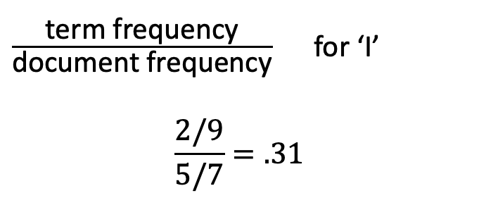
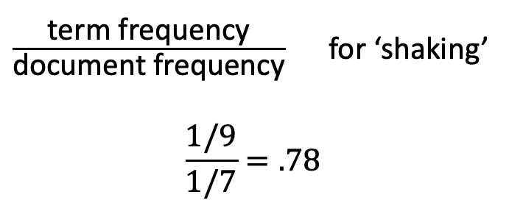
term frequency-inverse document frequency (tf-idf)
What helps with morning sickness?
How many months should I breastfeed?
I passed out and Mom said I was shaking
Where is the nearest clinic?
I am having heavy bleeding, what should I do?
What foods should I eat while pregnant?
My heart is racing and I can’t catch my breath
$\frac{\text{term} \text{frequency}}{\text{document} \text{frequency}}$ for ‘shaking’
$$\frac{1/9}{1/7}=.78$$
$\frac{\text{term} \text{frequency}}{\text{document} \text{frequency}}$ for ‘I’
$$\frac{2/9}{5/7}=.31$$
Notes:
Putting these two ideas together, we get a modified version of the bag of words features discussed before –
It’s called term-frequency inverse document frequency, or tf-idf
Let’s look at the tf-idf feature for ‘shaking’ in the sentence highlighted in red
There are 9 words in the sentence, and shaking appears once, so its term frequency is 1 over 9
Looking at the document frequency, this word appears in only one of the seven sentences, so its document frequency is 1 over 7
If we multpily the term frequency by the inverse document frequency – which is another way to say to divide the term frequency by the document frequency –
We get 1 over 9 divided by 1 over 7, which is 7/9ths, or .78
Let’s contrast that with the tf-idf feature for ‘I’ in the same sentence. Since ‘I’ appears twice in that sentence, its term frequency is higher – 2/9ths.
However, since ‘I’ appears in 5 of the 7 sentences, its document frequency is also much higher – 5/7, resuting in a tf-idf feature of .31, much lower than the feature for ‘shaking’

Slide 31
Preprocessing
I passed out, and Mom said I was shaking.
remove punctuation
to lowercase
“tokenization”
“stemming”
I passed out and Mom said I was shaking
i passed out and mom said i was shaking
[i, passed, out, and, mom, said, i, was, shaking]
[i, pass, out, and, mom, said, i, wa, shake]
Notes:
There are a few other steps required to convert documents to features that are conceptually simple, but important
We’ll go over these in more detail in our computational exercise
Typically we begin by removing punctuation from our sentences and converting all words to lowercase
We don’t want capitalized words to be considered to be different words from their non-capitalized counterparts, for example
Once that’s done, we can split sentences on whitespace so that we can count the individual words
This isn’t meaningful on paper, but is important when implementing the process in code
Finally, in some cases we may also want to use stemming, which removes the endings of words so that ‘pass’ and ‘passed’ correspond to the same feature, for example
Alternatively, you may hear about lemmatization, which is very similar to stemming, but incorporates a bit more linguistic knowledge

Slide 32
Summary
A central challenge of NLP lies in converting text documents into feature vectors that can be used in a predictive model
Bag of words models solve this challenge by constructing a feature vector based on counts of each word of interest
Even though they ignore word order and semantic relationships, these models are very powerful
Notes:
In summary…
Bag of words models solve this challenge by constructing a feature vector in which each element corresponds to a distinct word of interest, and its value is determined by counting the occorrences of that word in the document (or message, or passage)

